Slide 1
LHH
DevOps
Build & Release Model
COMPaaS/Sitecore
Nitesh Sharma/Randy Rahbar

Slide 2









Continuous Integration Pipeline
Continuous Integration is iterative process to integrate the team work frequently which is verified by automated build, unit and security test to detect bug and fix them early. It speed up the feedback gathering mechanism and gain insight much faster.
Feedback to Developer
Comments, Validation
Error
Static Code Rule Warnings
OSS Vulnerabilities Security issue
Code Review & Build Validation
Build Error
Failed Unit Test
Approved
Unit Test
Static Code Analyzers
Inspect OSS & Code Quality
Packaging
Source Control
Build
*Build Validation:
Credential Scanner
UTC Checks
Build status
Mandatory Reviewers
Azure DevOps
Tool options:
Tool options:
Docker
Request for
Code Merge
Azure GIT Repo
*Build Tasks:
Dotnet Build
Credential Scanner
Environment specific Token Replacement
Build Docker images
Use Variable Group for common variables
*Roslyn Analyzers
*BinSkim
Code
Repository
Tools-
Publish Container images Azure Container Registry
Publish build artifact to Azure Artifact
Developer

Slide 3
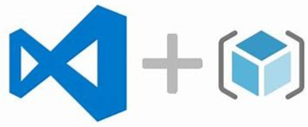






Continuous Delivery Pipeline and Tooling
Continuous delivery allows to deliver new business value and improve existing software faster, with lower risk. It is a practice of keeping codebase deployable at any point, having passed all the quality gates and with all the configuration necessary to push it into any environment.
Deploy to QA
Configuration
Dynamic Code Analysis
Performance Testing
Regression Testing
Quality Gate Passed
Not yet implemented
Load Runner
ARM Templates
After passing QA, and with the proper approval, the application can be promoted to higher environments like UAT and then Production. The pipeline generally remains the same. Only the TARGET environment changes.
Approved
Deploy to UAT
Execute Acceptance testing
Approved
Deploy to Prod
Monitoring
Azure Monitoring
Azure App Insights
Azure Log Analytics

Slide 4
Current CI/CD Toolset
Task | Tool | Description
Source Control | Azure Repos | A set of version control tools that you can use to manage your code.
Unit Test | nUnit | Open-source unit testing framework used for development and execution of unit tests with .NET programming language.
Static Scan Analysis/OSS Code Quality | Credential Scanner | Static analysis tool that detects credentials, secrets, certificates, and other sensitive content in your source code and your build output.
 | BinSkim | Portable Executable (PE) light-weight scanner that validates compiler/linker settings and other security-relevant binary characteristics.
 | TSLint | Static analysis tool that checks TypeScript code for readability, maintainability, and functionality errors.
 | Roslyn Analyzer | Microsoft's compiler-integrated static analysis tool for analyzing managed code (C# and VB).
 | Anti Malware Scanner | Windows Defender Anti-Malware scan.

Slide 5
Current CI/CD Toolset (cont.)
Task | Tool | Description
Container Registry | Azure Container Registry | Managed Docker registry service that allows you to store and manage images for all types of container deployments.
Artifact Repository | Azure Artifacts | Extension that makes it easy to discover, install, and publish packages in Azure DevOps.
Sitecore Deployment | Unicorn | Sitecore utility designed to simplify deployment of Sitecore items across environments.
Configuration Management | Ansible | Open-source software provisioning, configuration management, and application-deployment tool enabling infrastructure as code.
Performance Testing | JMeter | Open-source software designed to load test functional behavior and measure performance.
Regression Testing | Selenium | Open-source automated testing framework used to validate web applications across different browsers and platforms.
Monitoring | Azure Monitor, App Insights, Log Analytics | https://azure.microsoft.com/en-in/pricing/details/monitor/ https://docs.microsoft.com/en-us/azure/azure-monitor/app/pricing

Slide 6
To Be Implemented
Task | Tool | Comments
Dynamic Code Analysis | Veracode | We were planning on using MSRD for the dynamic code analysis, but it has been decommissioned by Microsoft. We’re currently looking into implementing Veracode.
Test Automation | Jenkins | We are in the process of setting up an automation framework and integrating with ADO.
MSCA Reporting/Dashboard | ? | One of the downsides of the MSCA products is that there isn’t a consolidated report or dashboard to view any reports. We’re hoping to find a solution to this.
Static Code Analysis | SonarQube | Researching the use of SonarQube to implement additional static analysis of code to detect bugs and security vulnerabilities.

Slide 7
References
Microsoft Security Development Lifecycle – great resources to get started
Microsoft Security Code Analysis Documentation
Onboarding & Installation Guide
Roslyn for .Net Core
https://github.com/dotnet/roslyn-analyzers
TSLint for TypeScript
https://github.com/palantir/tslint
Current Pipelines
https://inoffice.sharepoint.com/:x:/r/sites/LHHITApplicationDevelopment/Shared%20Documents/General/DevOps/Build%20and%20Release%20Management/ADO%20Pipelines.xlsx?d=wb2bab7a878184b6095a5e9d5d53e95f3&csf=1&web=1&e=SrOHqI

Slide 8
Appendix

Slide 9
Code Branching Strategy
At the core the code repository will have Four main branches For MicroServices and SiteCore Solution–
Master
Release (UAT)
QA
Development
The Master branch is the origin branch and will always contain the production ready code.
The Development branch will first time spawn from Master branch and will always contains the latest development changes for next release. When the source code in develop branch will be stable it will be merged to QA branch and so on.
Supporting Branches –
Apart from main branch development model will use variety of supporting branches to enable the parallel development among team members. These branches have a limited life-time and can be release once purpose is achieved.
Following are the supporting branches can be used in development model –
Feature Branches
HotFix Branches
Initial Version
Master
Develop
Prod Release
Next Prod release
Work in Progress

Slide 10
Feature Branch
Feature/Bug Branch –
Feature Branch are used to develop new feature for the upcoming future release. It will exist as long as the feature is in the development and will e merged back into Develop branch.
Feature branch will branch off from - Develop
Will be merged back to – Develop
And will be deleted once the development is completed.
Develop
BugFix
feature
Naming Convention-
Features/PBI<PBI Number>
Example: Features/PBI12345

Slide 11
Release Branch
Release Branch (UAT) –
This branch is used to deploy code in UAT Environment for final signoff . For any bug in release branch, we create a bug branch from here and fix the bug. Then, Merge the Bug in Development branch for code review once code review accepted. We merge the same in Release branch.
UAT Week: Any bug fix during this period will be fix in separate Bugfix branch originated from UAT branch and merged into Development branch. Need to share the PR no. with DevOps team to push the change in QA. Once, QA sign-off. Same PR will be merged into UAT Branch.
Bug Fix branch during UAT Week – Merged back to Dev and Release
Release branch will branch off from - Develop
Will be merged back to – Master
Prod version
Master
Release
Develop
Prod Version
Step | UAT Build?
Sprint 1 (2 weeks) | No - UAT/Pre-Prod Overlap from Previous Release
Sprint 2 (2 weeks) | Yes - Full builds (all checked-in changes)
Merge & Regression (1 week) | Yes - Full builds (all checked-in changes)
UAT (1 week) | Yes - Bug fixes only (by BugFix Branch)
Pre-Prod (1 week) | No - Preparation for Release
Work in Progress

Slide 12
HotFix Branch
Hotfix Branch –
Hotfix Branch created when a critical bug in production environment must be resolved immediately. A hotfix branch created from the master production branch.
Hotfix branch will branch off from - master
Will be merged back to – Develop and Master
And will be deleted once the release is completed.
Prod version
HotFix
Master
Develop
Naming Convention-
HotFix/<Current production version>_HF<Number>
Example: HotFix/2020_Aug_HF1
Prod Version
Work in Progress
Prod bug fix

Slide 13
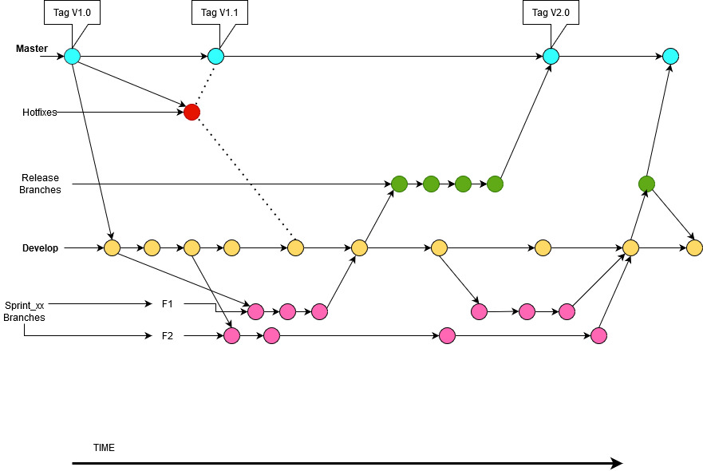
Branching Strategy

Slide 14
Branching Strategy
Rules :–
Once feature branch pull request reviewed. Delete the source Branch at the time of Pull request completion.
Follow the Naming Convention while create branch in your local machine for PBI. As, same will be push on Remote origin. Example: Features/PBI23465
Follow the Naming Convention while create branch in your local machine for Bugs. As, same will be push on Remote origin. Example: BugFixs/Bug23465
Always create local branch from the origin/dev1 branch.
Comment format while raise any Pull Request:
<PBI/Bug>:<Number>|<RespectiveTitle>

Slide 15
Roles and Permissions
To support the pipeline, user can be added to a built-in security group, set individual permissions for a user or group, or add users to pre-defined roles. The most common built-in group are -
Readers
Contributors
Project Administrators
The following roles will be defined for DevSecOps
Developer
View logs of CI/CD pipeline
Request code merge
Request build
Release Manager – Following access control can be given to build manager
Approve code merge
Create/Edit/Delete build definition
Start/Stop build
Manage build queue
Manage build quality
DevSecOps Manager
Manage the build and adjustments to the pipelines
Manage users and permissions
Review all pipeline activities

Slide 16
Troubleshooting the Pipeline
If the CI/CD pipeline fails to complete successfully, we can view the log by navigating to pipeline run summary and selecting failed jobs and task.
In addition, we can download the complete log which includes additional diagnostic information which will help in troubleshooting the issue .
View and download logs
Worker diagnostics logs
Agent diagnostics logs
Other Log
Http Trace log
We can also Configure more verbose logs by enabling the “System Diagnostic” in pipeline execution to diagnose and fix any issue.

